Slide 1

Overview of the Year 4 Workplan & Reporting Requirements
October 1, 2018 to September 30, 2019

Slide 2

Waiver for Extension
The U.S. Department of Education published a Final Waiver and Extension of the Project Period for Notice of Proposed Requirement on August 14, 2018 proposing a change to the maximum project period of the Migrant Education Program (MEP) Consortium Incentive Grant (CIG) program.
The waiver and extension enables the 34 grantees under the MEP CIG Program that received awards in the fiscal year (FY) 2015 grant competition to continue to receive Federal funding for up to 24 additional months, beginning on October 1, 2018.

Slide 3
Priority Needs Identified by
IRRC Member States for the Extension
The need for greater efficiency in ID&R through electronic solutions for decision making to determine eligibility and standardize quality control.
The need for professional development (PD) to build and sustain capacity in ID&R professionals and their administrators.
The need for ID&R resource coordination and mentoring within and across states.
The need for continuity, coordination, and dissemination of ID&R practices across states.

Slide 4
Key IRRC Extension Activities
Identify vendors with expertise to develop an electronic system to increase states’ ability and efficiency in identifying and recruiting eligible migrant children and youth.
Develop and pilot an electronic ID&R system that features a series of questions to help states determine migrant student eligibility and govern the quality of decision making.
Conduct an assessment of needs to inform capacity in both veteran and new recruiters and administrators.
Develop a 2-tiered, needs-based ID&R professional development plan for states that incorporates successful ID&R strategies and lessons learned.
Disseminate high quality ID&R models, methods, and materials nationally through mentoring, modeling effective practices, materials distribution, and vetted updates to the IRRC website.

Slide 5
Expanded ID&R efficiency, quality, and reliability
ID&R electronic solutions
Professional development in ID&R
ID&R resource coordination/ continuity

Slide 6
IRRC States
Oklahoma dropped out from both IRRC and the Reading CIG
All other States remained:
Arizona Iowa New York
Colorado Kansas South Carolina
Delaware Maine Tennessee
Georgia Nebraska (Lead State)
Illinois New Mexico

Slide 7
Year 4 IRRC Roles
Leadership Team = Sue Henry (Lead State), John Farrell (Lead State Support), Mary Mulloy (TST Lead), Cari Semivan (Evaluator)
State Steering Team (SST) = 13 IRRC State Directors (or their designees)
Technical Support Team (TST) = Representatives of the 13 IRRC States
TST Workgroups = (1) Technology, (2) TRI, (3) Professional Development and Mentoring, (4) Dissemination
Technology Contractor = PCG – Public Consulting Group

Slide 8

IRRC Extension Goals, Objectives, and Performance Measures

Slide 9
Goal 1, Objective 1, Performance Measure 1a
Goal 1: Improve States’ capacity to make recruitment decisions via technology.
Objective 1: By the end of Year 4, develop an electronic system that helps recruiters efficiently and effectively determine migrant student eligibility.
Performance Measure 1a: By the end of Year 4, a reliable electronic system for eligibility determinations will be developed.

Slide 10
Goal 1 Key Activities – Year 4
Identify contractor
Establish the criteria for ID&R decision making
Develop the electronic system
Convene/participate in 4 TST meetings
Provide training to States on the field test process for the electronic system

Slide 11
Goal 1 Activities | Timeline | Person(s) Responsible
1.1 Identify and contract a vendor with expertise in technology-based solutions and knowledge/understanding of the MEP and ID&R | 12/31/18 | LT/St
1.2 Establish the criteria for ID&R decision making to ascertain levels of certainty, quality control, and ID&R flow-chart decision-making | 1/31/19 | WL/TST/LT/St
1.3 Oversee the work of the contractor during Year 4 | 1/19-9/19 | LT
1.4 Convene/prepare for the State Steering Team (SST) Meeting in Phoenix, AZ | 1/19 | LT
1.5 Attend the SST Meeting in Phoenix, AZ in January | 1/19 | St/C/LT
1.6 Convene/prepare for the State Steering Team (SST) lunch meeting in New Orleans, LA | 5/19 | LT
1.7 Attend the SST lunch meeting in New Orleans, LA in May | 5/19 | St/C/LT
1.8 Schedule/prepare meeting materials for 4 TST meetings/webinars/year | Quarterly | WL/LT
1.9 Participate in 4 TST meetings/webinars/year | Quarterly | WL/TST/LT
1.10 Provide input/suggestions on the electronic system | 5/19 | WL/TST/St/LT
1.11 Prepare a beta version of the electronic system with input from the SST/TST | 7/19 | C
1.12 Develop field test data collection forms/processes | 8/19 | E
1.13 Convene/prepare for the State Steering Team (SST) Meeting in Fall 2019 | 9/19 | LT
1.14 Attend the SST Meeting in Fall 2019 | 9/19 | St/C/LT
1.15 Provide training to States on the field test process at the Fall 2019 SST Meeting | 9/19 | E
1.16 Submit evaluation data on Objective 1 services, participation, effectiveness | 8/19-9/19 | St/TST/LT
1.17 Report on progress toward Objective 1 in the Annual/Final Performance Report | 12/19 | LT
NE=Nebraska (Lead State); LT=Leadership Team; St=State Directors; WL=Workgroup Leader; E=Evaluator; TST=Technical Support Team; C=Contractors; MEP=MEP Staff/Recruiters

Slide 12
Goal 2, Objective 2
Goal 2: Improve MEP staff/recruiters’ capacity to identify and recruit migrant students
Objective 2: By the end of Year 4, 90% of staff participating in IRRC professional development and TRI visits will report that they increased their capacity to conduct/support identification and recruitment.

Slide 13
Goal 2 Performance Measures
Performance Measure 2a: By the end of Year 4, 90% of staff participating in IRRC professional development will increase their capacity to conduct identification and recruitment as measured by a statistically-significant gain (p<.05) on a pre/post assessment.
Performance Measure 2b: By the end of Year 4, 90% of staff participating in IRRC technical assistance visits will increase their capacity to conduct identification and recruitment as measured by a statistically-significant gain (p<.05) on a pre/post assessment.

Slide 14
Goal 2 Key Activities – Year 4
Create/distribute a needs assessment survey to determine staff training needs
Identify experienced mentors and coaches from IRRC States
Develop a 2-tiered (veteran/novice staff) ID&R training model
Conduct ID&R professional development visits to IRRC States and beyond
Conduct/participate in ID&R training in each IRRC State
Prepare technical assistance (TA) materials tailored to States
Conduct/participate in IRRC TA visits in States

Slide 15
Goal 2 Activities | Timeline | Person(s) Responsible
2.1 Schedule/prepare meeting materials for 4 TST meetings/webinars/year | Quarterly | WL/LT
2.2 Participate in 4 TST meetings/webinars/year | Quarterly | WL/TST/LT
2.3 Create a needs assessment survey to determine training needs and preferred delivery methods | 12/18 | WL/TST/E
2.4 Administer the needs assessment survey to novice and veteran ID&R staff in each IRRC State | 1/19-2/19 | St
2.5 Analyze the results of the needs assessment survey and review to plan PD | 3/19 | E/WL/TST
2.6 Identify experienced ID&R mentors and coaches from the IRRC States | 2/19-4/19 | WL/LT/TST
2.7 Develop a 2-tiered ID&R training model (for veteran/novice staff) and materials | 8/19 | WL/TST
2.8 Conduct ID&R PD visits to IRRC States and beyond (as resources allow) | 1/19-9/19 | WL/TST
2.9 Provide requested PD at the ID&R Forum and other venues that support recruiters | 10/18 | WL/TST
2.10 Conduct/participate in 2 regional and/or virtual ID&R PD sessions | 9/19 | St/WL/TST/MEP
2.11 Conduct/participate in 2 virtual mtgs connecting MEP directors with ID&R resources | 9/19 | St/WL/TST/MEP
2.12 Prepare a pre/post staff survey to accompany technical assistance (TA) | 12/18 | E/WL
2.13 Prepare IRRC TA materials tailored for States (agendas, PPTs, activities, handouts) | 1/19-9/19 | WL/TST
2.14 Conduct/participate in IRRC TA visits in States | 1/19-9/19 | TST/MEP
2.15 Complete surveys on IRRC TA visits in States | 1/19-9/19 | MEP/TST
2.16 Analyze and summarize TA survey results | 9/19 | E
2.17 Submit evaluation data on Objective 2 services, participation, effectiveness | 8/19-9/19 | St/TST/LT
2.18 Report on progress toward Objective 2 in the Annual/Final Performance Report | 12/19 | LT
NE=Nebraska (Lead State); LT=Leadership Team; St=State Directors; WL=Workgroup Leader; E=Evaluator; TST=Technical Support Team; C=Contractors; MEP=MEP Staff/Recruiters

Slide 16
Goal 3, Objective 3, PM 3
Goal 3: Increase States’ capacity to conduct identification and recruitment through the dissemination of high quality ID&R models, methods, and materials through mentoring, modeling effective practices, and vetted updates to the IRRC website.
Objective 3: By the end of Year 4, 90% of IRRC State Directors surveyed will report that IRRC dissemination activities increased their State’s capacity to implement effective and promising practices in identification and recruitment.
Performance Measure 3a: By the end of Year 4, 90% of IRRC State Directors surveyed will report that IRRC dissemination activities increased their State’s capacity to conduct effective and efficient identification and recruitment.

Slide 17
Goal 3 Key Activities – Year 4
Maintain and update the IRRC website
Survey IRRC States to determine if additional models, methods, materials are needed to improve States’ capacity to conduct ID&R
Create/adapt one product identified by States – if needed
Establish protocols for mentoring and modeling effective ID&R practices
Disseminate ID&R materials across IRRC States based on recruiter/administrator needs
Disseminate successful ID&R strategies at the ID&R Forum and other MEP-related conferences and meetings

Slide 18
Goal 3 Activities | Timeline | Person(s) Responsible
3.1 Schedule/prepare meeting materials for 4 TST meetings/webinars/year | Quarterly | WL/LT
3.2 Participate in 4 TST meetings/webinars/year | Quarterly | WL/TST/LT
3.3 Maintain and update the IRRC website to increase access to effective and promising practices in ID&R and improve States’ efficiency and effectiveness | 10/18-9/19 | WL/TST
3.4 Provide links on the IRRC website to successful resources and information for recruiters and their administrators | 10/18-9/19 | WL/TST
3.5 Survey IRRC States to determine if additional models, methods, materials are needed to improve States’ capacity to conduct ID&R | 10/18-11/18 | WL/TST/E
3.6 Analyze results of the survey and determine what is needed to meet State needs | 12/18 | E/WL/TST
3.7 Create/adapt one product identified by States, if needed | 3/19-9/19 | WL/TST
3.8 Establish protocols for mentoring and modeling effective ID&R practices | 2/19 | WL/TST
3.9 Disseminate ID&R materials across IRRC States based on recruiter/administrator needs | 10/18-9/19 | WL/TST/St
3.10 Disseminate successful ID&R strategies at the ID&R Forum and other MEP-related conferences and meetings | 10/18-9/19 | WL/TST/St
3.11 Submit evaluation data on Objective 3 services, participation, effectiveness | 8/19-9/19 | St/TST/LT
3.12 Report on progress toward Objective 3 in the Annual/Final Performance Report | 12/19 | LT
NE=Nebraska (Lead State); LT=Leadership Team; St=State Directors; WL=Workgroup Leader; E=Evaluator; TST=Technical Support Team; C=Contractors; MEP=MEP Staff/Recruiters

Slide 19
Year 4 TST and SST Meetings
TST Meetings:
1. November 28-29, 2018 in Atlanta, GA
2. Virtual Meeting (February/Date TBD)
3. April 10-11, 2019 in Omaha, NE
4. Virtual Meeting (Date TBD)
SST Meetings:
1. Sept. 21, 2018 in Clearwater, FL
2. January 23, 2019 in Phoenix, AZ
3. May 2, 2019 in New Orleans, LA
4. Fall 2019 (Date/location TBD)

Slide 20

Year 4 Evaluation

Slide 21
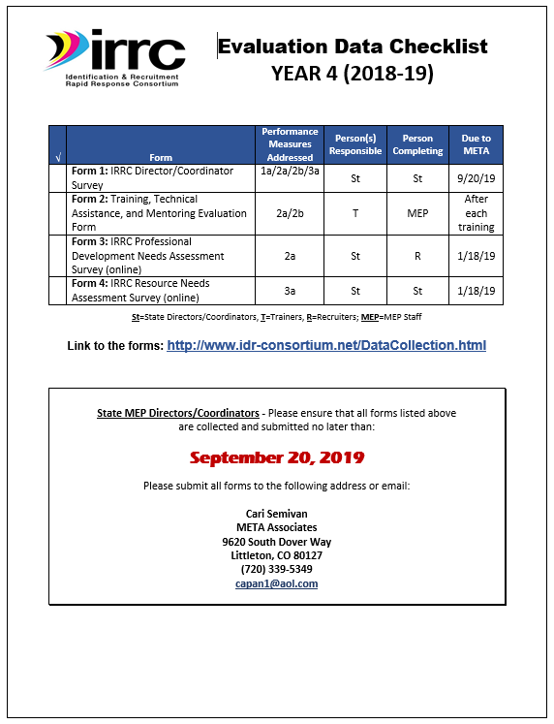
The Year 4 Evaluation Data Checklist shows the data to be collected for the evaluation, the performance measures addressed, the persons responsible for disseminating the forms, the persons completing the forms, and due dates.
All forms can be found on the IRRC Website
http://www.idr-consortium.net/DataCollection.html
Final due date for all forms: September 20, 2019

Slide 22
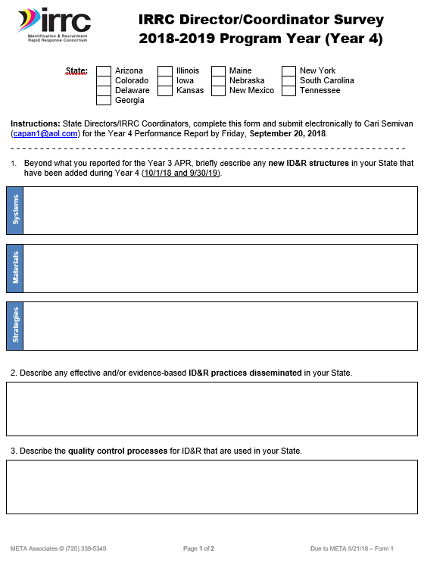
Form 1 will be completed by IRRC State Directors/ Coordinators at the end of Year 4
Form 1 is due to Cari by September 20, 2019

Slide 23
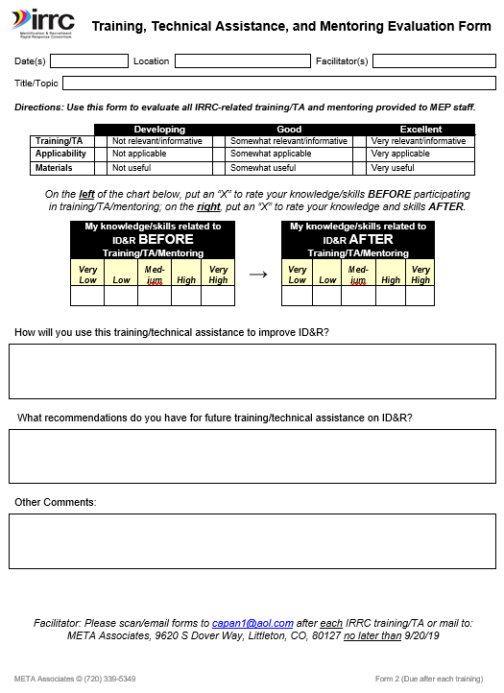
Addresses Performance Measures 2a and 2b
Please distribute Form 2s at every IRRC/IR&R training or TRI visit in each IRRC State during Year 4
Scan and email Form 2s to cari@meta1.us after each training

Slide 24
Form 3 and Form 4: IRRC Training and Resource Needs Assessments
Developed by the Professional Development and Dissemination Workgroups and Evaluator
Assesses the training needs of ID&R staff in the IRRC States and informs if additional models, methods, materials, are needed to improve State’s capacity to conduct ID&R
Addresses Performance Measures 2a, 2b, and 3a

